Slide 1
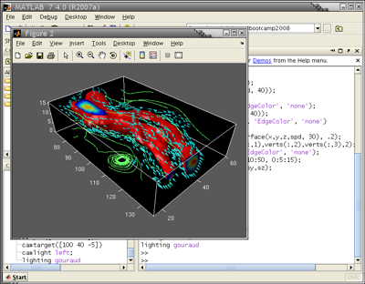

Introduction to Scientific Programming in MATLAB
Derrick Kearney
HUBzero® Platform for Scientific Collaboration
Purdue University
Original slides by Michael McLennan
This work licensed under
Creative Commons
See license online:
by-nc-sa/3.0

Slide 2
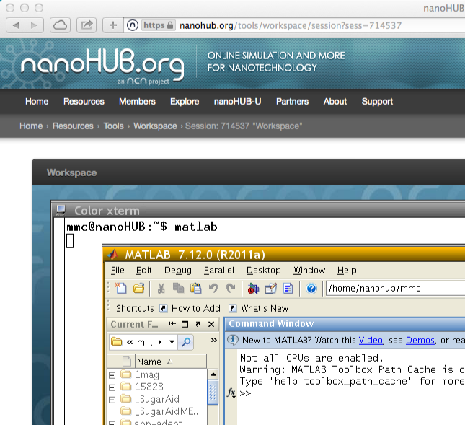

Accessing MATLAB
Start a workspace and type matlab
NOTE: MATLAB requires a
license from Purdue, so this
works only when accessing
from Purdue’s campus.
Try some simple commands:
>> x=1
>> y=2
>> z=2*x + y
>> exit

Slide 3
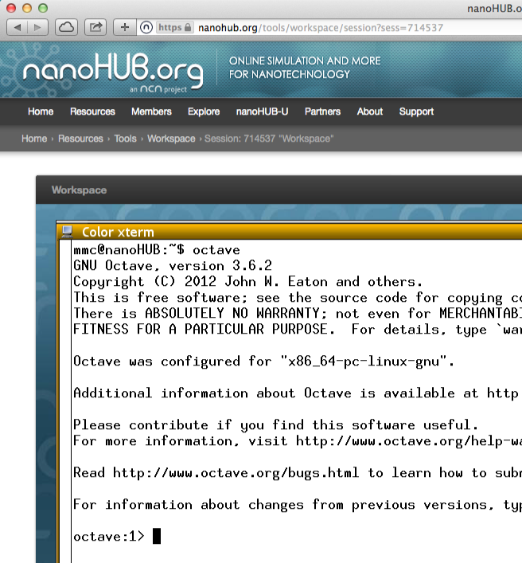
Free Clone: GNU Octave
In your workspace, type octave
☑ Runs almost all MATLAB scripts
☑ Creates plots
☒ Missing fancy debugger
☒ Missing “simulink” toolbox

Slide 4
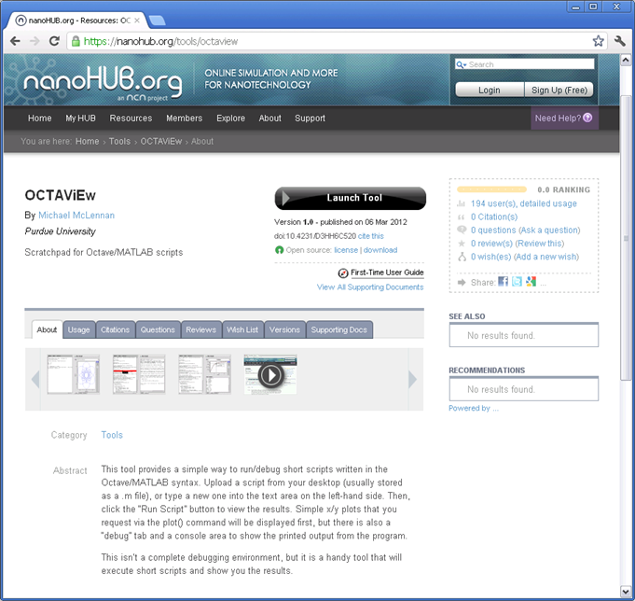
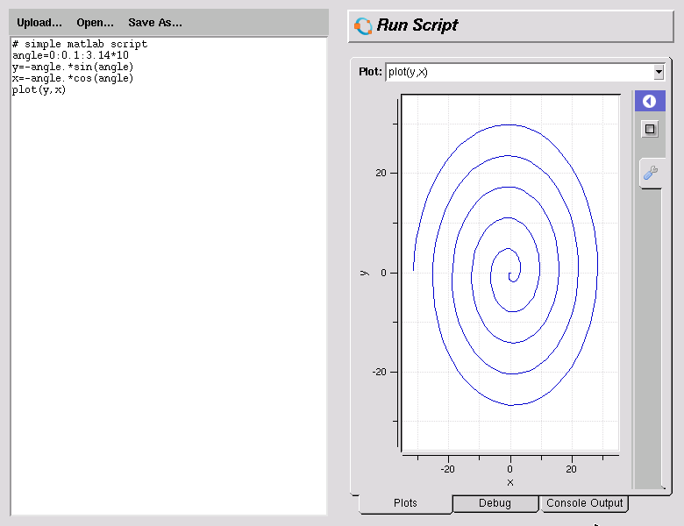
Introducing… OCTAViEw
http://nanohub.org/tools/octaview
☑ Quick and dirty
☑ Simple plots

Slide 5
Using Vectors
Create a series of number like this:
xaxis
1.0 1.1 1.2 1.3 … 4.8 4.9 5.0
xaxis = 1:0.1:5
xaxis = linspace(1,5,41)
start with this
start with this
increment by this
end with this
end with this
number of points
Try this:
>> xaxis = 1:0.1:5;
>> length(xaxis)
>> xaxis
Try it with/without the semicolon.
What does the semicolon do?

Slide 6
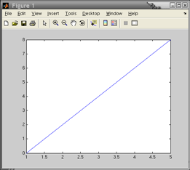
More Vectors
Suppose you have an irregular spacing:
xaxis
1.0 1.1 3.0 4.9 5.0
xaxis = [1.0, 1.1, 3.0, 4.9, 5.0]
square brackets
comma-separated list of values
Multiply element by element:
[1.0 1.1 …] [1.0 1.1 …]
Try this:
>> y = 2*xaxis – 2
>> plot(xaxis,y)
>> y = 3*xaxis*xaxis + 1
>> y = 3*xaxis.*xaxis + 1

Slide 7
Matrices
Suppose you want to define a matrix, like this:
-1 -1 -1
0 0 0
1 1 1
in MATLAB, that’s
>> a = [-1 -1 -1 ; 0 0 0 ; 1 1 1]
a =
-1 0 1
-1 0 1
-1 0 1
in MATLAB, that’s
>> a’
a^{T} =
Try this:
>> a * a’
>> a’ * a
>> a’ * a + 1
Try these built-in functions:
>> zeros(3)
>> ones(4)
>> eye(2)
>> a * a’ + eye(3)

Slide 8
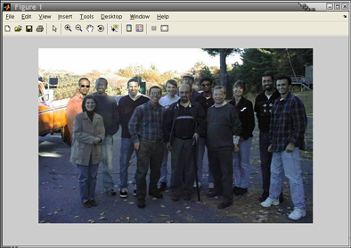
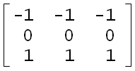

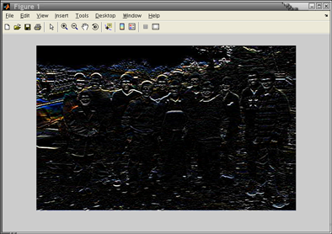
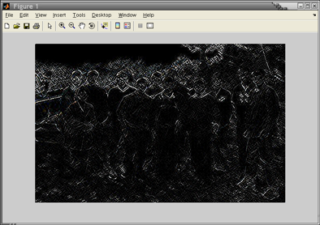
Image Processing
Try this:
>> fp = fullfile(toolboxdir('simulink'),'simulink','simulinkteam.jpg');
>> im = imread(fp);
>> figure;
>> imshow(im);
>> a = [-1 -1 -1 ; 0 0 0 ; 1 1 1]
>> im2 = imfilter(im, a, ‘conv’);
>> imshow(im2);
>> im2 = imfilter(im, a*a’, ‘conv’);
‘conv’
operation
Edge detection!
>> imshow(im2);
Octave Users:
Works in Octave 3.0
For earlier versions, download imread from
charcoal effect
http://www.cs.helsinki.fi/u/ahyvarin/kurssi/imread.m

Slide 9
Matrix Indexing
-1 -1 -1
0 0 0
1 1 1
in MATLAB, that’s
>> a = [-1 -1 -1 ; 0 0 0 ; 1 1 1]
a =
Try this:
>> a(1,1)
>> a(2,1)
>> a(1,2)
Try this:
>> a(1,1:3)
>> a(1,:)
Try this:
>> a(2,2) = 3
>> a
whole row
column index
row index
Pick apart image pixel by pixel…
>> im(1,5)
>> im(3, :)
>> im(1:100, 1:100)

Slide 10
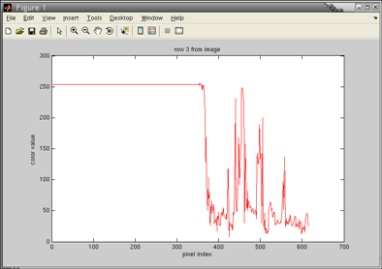
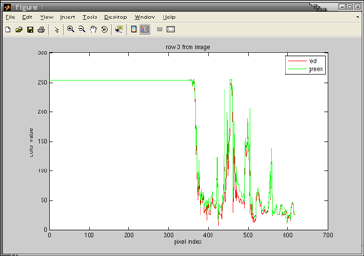
Back to Plotting
Try this:
>> rv = im(3, :, 1)
>> plot(1:length(rv), rv, ‘r’)
>> title(‘row 3 from image’)
>> xlabel(‘pixel index’)
>> ylabel(‘color value’)
>> hold
>> gv = im(3, :, 2)
>> plot(1:length(gv), gv, ‘g’)
>> legend(‘red’,’green’)
first component: r g b
all column elements
row index

Slide 11
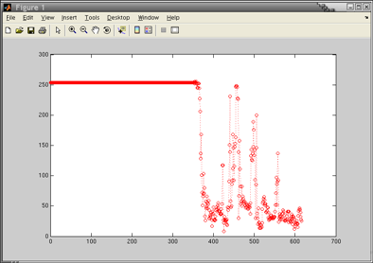

Plotting Options
Try this:
>> clf
>> plot(1:length(rv), rv, ‘r:o’)
red, dotted line, circles
r Red
g Green
b Blue
c Cyan
m Magenta
y Yellow
k Black
w White
- Solid line (default)
-- Dashed line
: Dotted line
-. Dash-dot line
+ Plus sign
o Circle
* Asterisk
. Point
x Cross
s Square
d Diamond
^ Upward-pointing triangle
v Downward-pointing triangle
> Right-pointing triangle
< Left-pointing triangle
p Five-pointed star (pentagram)
h Six-pointed star (hexagram)

Slide 12
Functions
file: edgematrix.m
% returns edge detection matrix of size n
% orient is 'horz' for horizontal edges, and 'vert' for vertical
function m = edgematrix(n,orient)
half = floor(n/2);
n = 2*half + 1;
for i=1:n
for j=1:n
if strcmp(orient,'horz')
m(i,j) = j-half-1;
else
m(i,j) = i-half-1;
end
end
end
im2 = imfilter(im, edgematrix(5,’horz’), ‘conv’);

Slide 13
Loops
file: edgematrix.m
% returns edge detection matrix of size n
% orient is 'horz' for horizontal edges, and 'vert' for vertical
function m = edgematrix(n,orient)
half = floor(n/2);
n = 2*half + 1;
for i=1:n
for j=1:n
if strcmp(orient,'horz')
m(i,j) = j-half-1;
else
m(i,j) = i-half-1;
end
end
end
j
i
-2 -2 -2 -2 -2
-1 -1 -1 -1 -1
0 0 0 0 0
1 1 1 1 1
2 2 2 2 2

Slide 14
Conditionals
file: edgematrix.m
% returns edge detection matrix of size n
% orient is 'horz' for horizontal edges, and 'vert' for vertical
function m = edgematrix(n,orient)
half = floor(n/2);
n = 2*half + 1;
for i=1:n
for j=1:n
if strcmp(orient,'horz')
m(i,j) = j-half-1;
else
m(i,j) = i-half-1;
end
end
end
-1 0 1
-1 0 1
-1 0 1
m =
‘horz'
-1 -1 -1
0 0 0
1 1 1
m =
anything else

Slide 15
Programming the MATLAB Way
file: edgematrix.m
% returns edge detection matrix of size n
% orient is 'horz' for horizontal edges, and 'vert' for vertical
function m = edgematrix(n,orient)
half = floor(n/2);
n = 2*half + 1;
for i=1:n
for j=1:n
if strcmp(orient,'horz')
m(i,j) = j-half-1;
else
m(i,j) = i-half-1;
end
end
end
% returns edge detection matrix of size n
% orient is 'horz' for horizontal edges, and 'vert' for vertical
function m = edgematrix2(n,orient)
half = floor(n/2);
o = ones(2*half + 1);
m = [-half:half]' * o(1,:)
if strcmp(orient,'horz')
m = m'
end
-1
0
1
1 1 1
-1 -1 -1
0 0 0
1 1 1
=

Slide 16
Simple Input/Output
file: hello.m
% prompt for a phrase and say "hello"
disp('Who are you?');
name = input('Enter your name: ','s');
age = input('Enter your age: ');
mesg = sprintf('Hello, %s!', name);
disp(mesg);
file = input('Enter a file name: ','s');
fid = fopen(file,'w');
fprintf(fid, '%s is %d years old\n', name, age);
fclose(fid);
String input
Numbers and
other stuff
>> hello
Who are you?
Enter your name: Michael
Enter your age: 43
Hello, Michael!
Enter a file name: info.txt
Use script name as a
command to invoke
the script

Slide 17
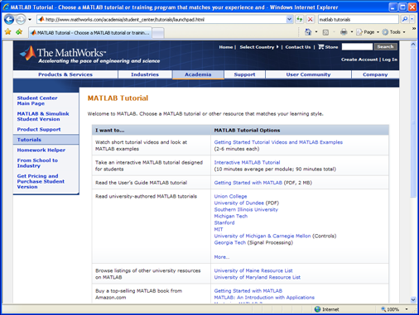
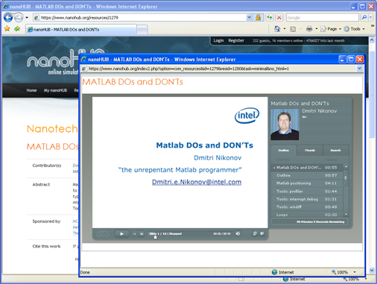
Other Resources
Tutorials at MathWorks
http://www.mathworks.com/academia/student_center/tutorials/launchpad.html
MATLAB DOs and DONTs
http://nanohub.org/resources/1279

